Slide 1
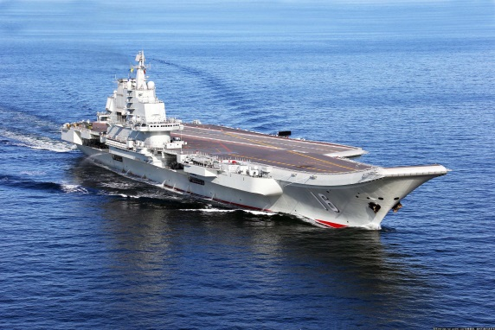
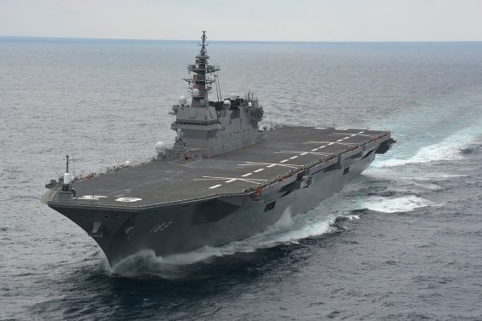
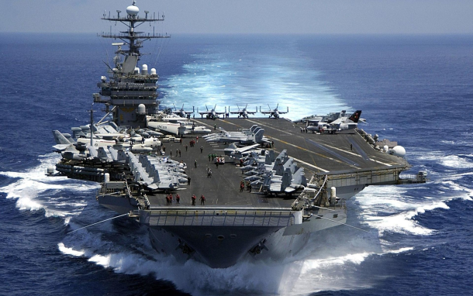
South China Sea
The Economic of Competing Territorial Claims
Chinese Internet HP
JMSDF HP
US Navy HP
November, 2016
OHARA, Bonji - The Tokyo Foundation

Slide 2
2 Directions of China’s Maritime Operation
Combination of "offshore waters defense" with "open seas protection"
Against U.S.
Support “a Belt and Road”
2 Directions are ordered by Admiral Liu Huaqing in 1980s and early 1990s
3 steps development, building aircraft career, global deployment of Navy fleet

Slide 3
The Meaning of “March Westward”
Battle with US Navy
Economic Hub at Inland China
Expand Economic Activity to West
Create Local Situation by China
Nuclear Deterrence & Asymmetric War

Slide 4
Meaning of SCS for China
China does not want to go into war with US
Military Presence to West
Theater - vs U.S. navy
Competition of Influence with U.S.
Strategic Patrol of SSBN
Sea Bed Resources
Maritime Transportation

Slide 5
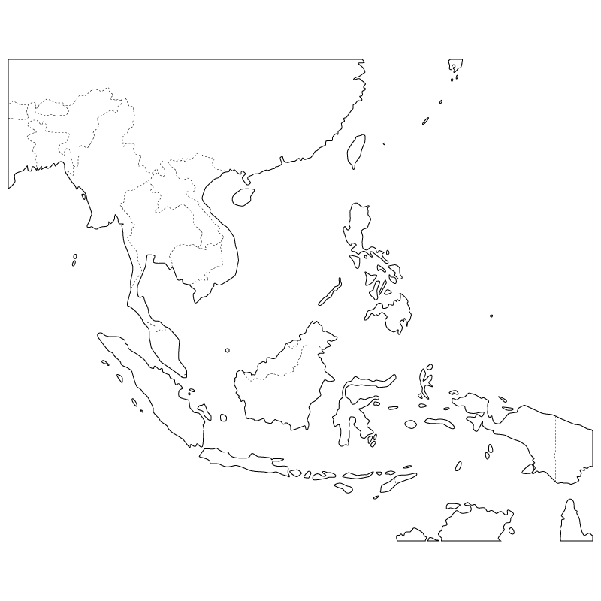
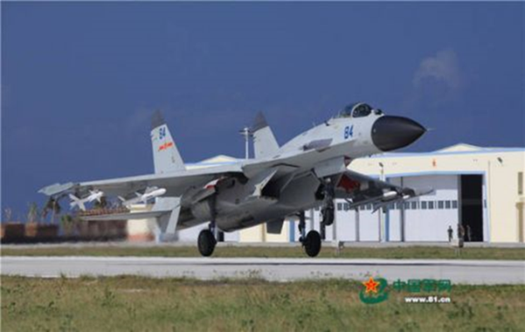

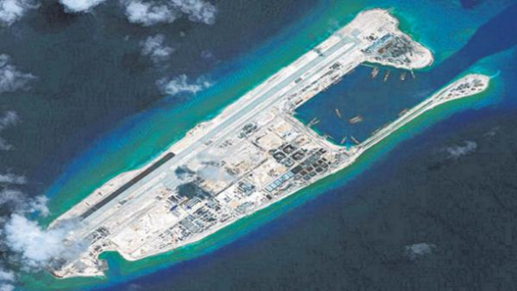
SCS as a Territorial Water
SSM : Range 400km
Include Subic Bay
Woody Island
Scarborough Shoal
SAM : Target US Aircraft
Fighter : Mutual Support
Gaven Reef
Fiery Cross Reef
HF RADAR : MDA in SCS
Subi Reef
Mischief Reef
Cuarteron Reef
Johnson South Reef

Slide 6
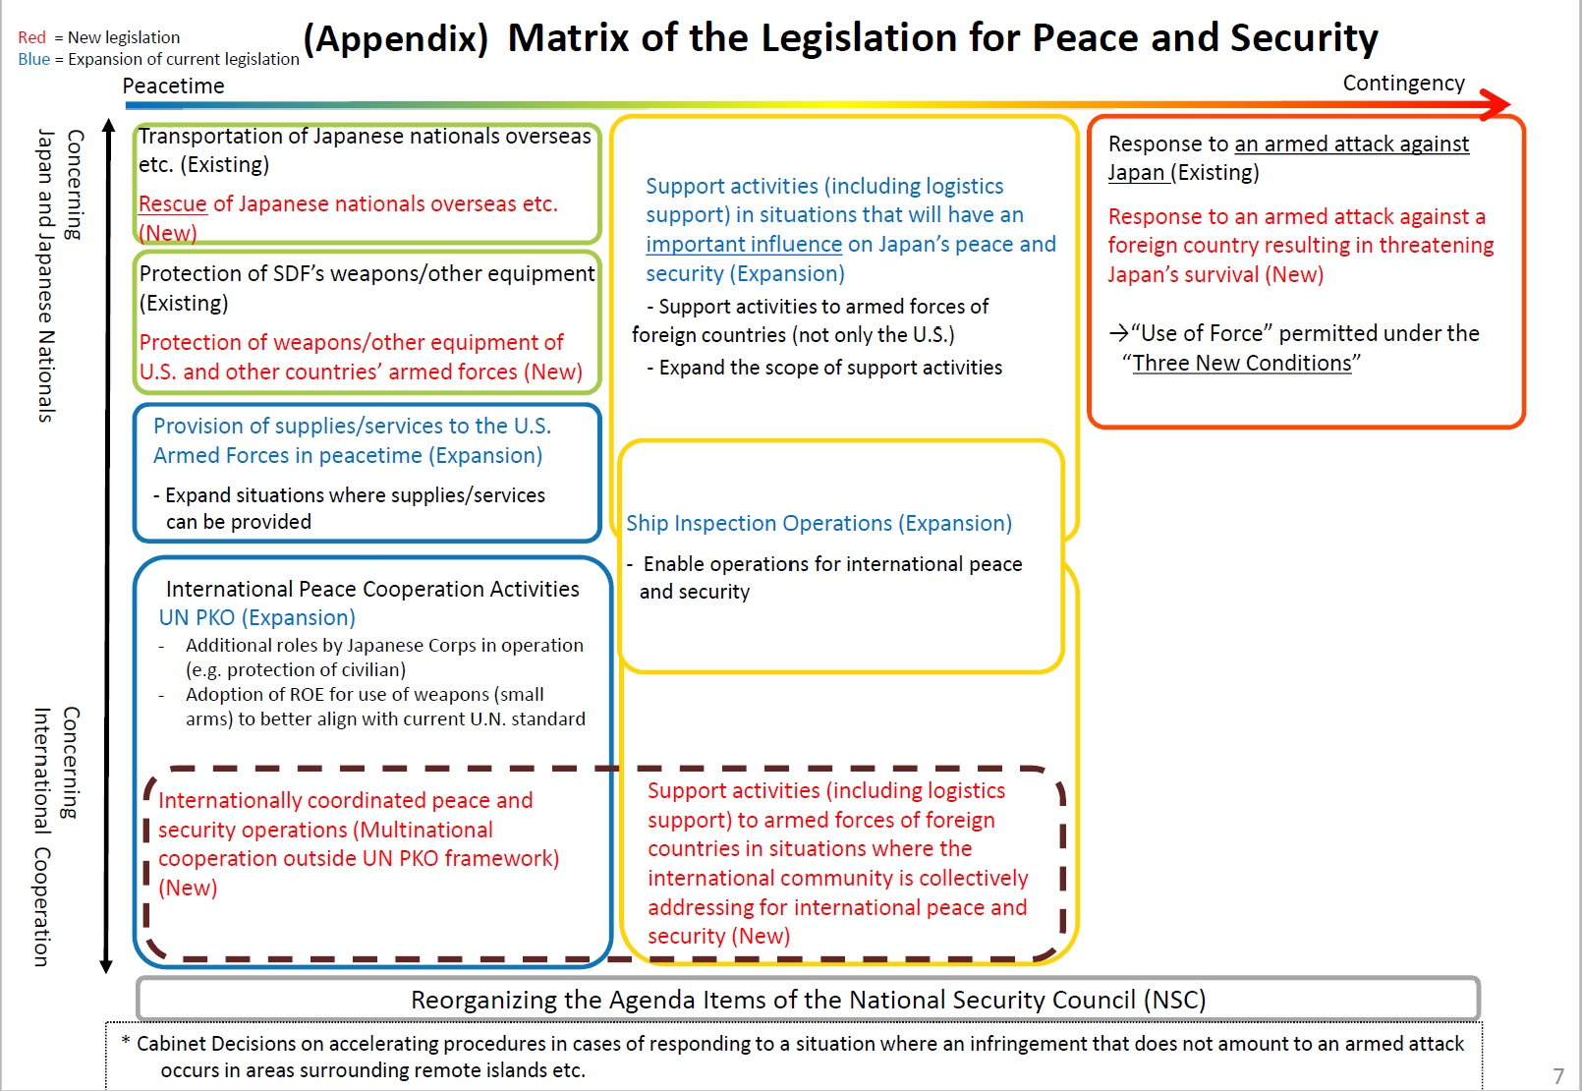

Slide 7
What should be Japanese attitude?
An absolute denial of the challenge to International Order by Violence
Japan must pursue two different goal at same time, without hesitation
Invalidate China’s purpose itself by showing Forces
Avoid severe military confrontation, at same time
Creating a new
“Common Value”
Make Balance
Stop the challenge
Creating 3rd Actor in the region – South East Asian Countries
Leave the Image of “U.S.-China Confrontation”

Slide 8
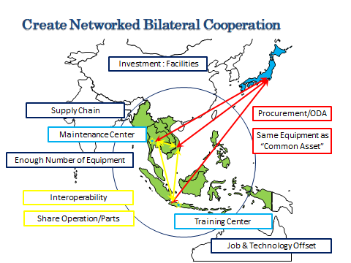

Slide 9
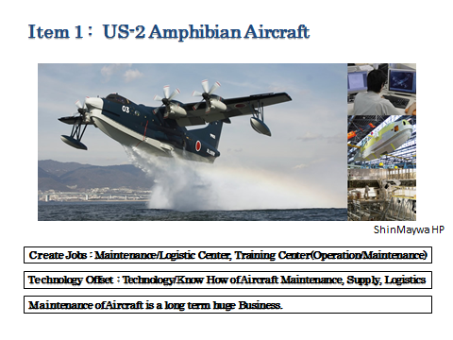

Slide 10
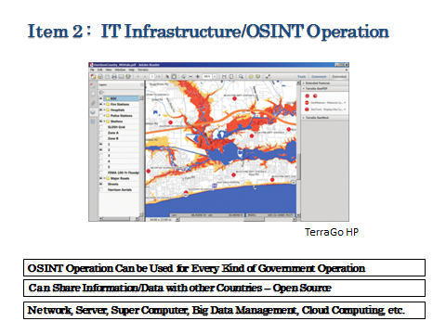

Slide 11
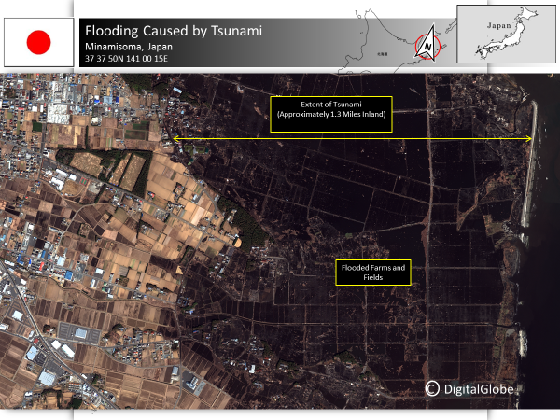

Slide 12
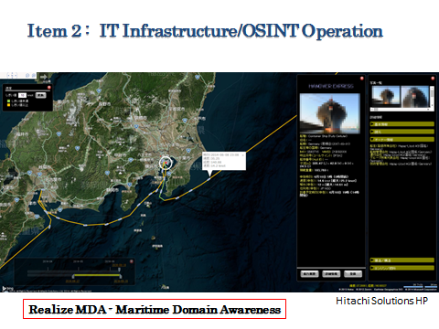

Slide 13
